Slide 1
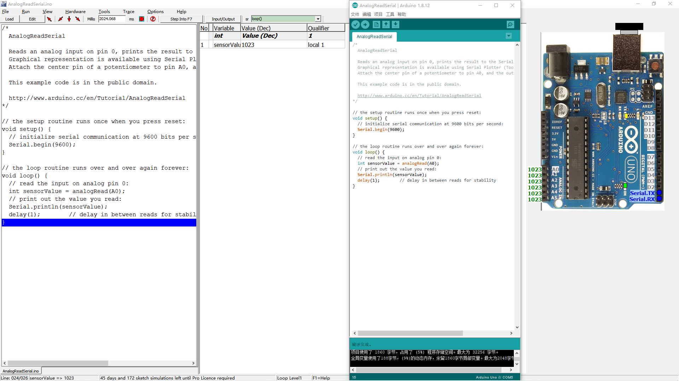
AnalogReadSerial

Slide 2
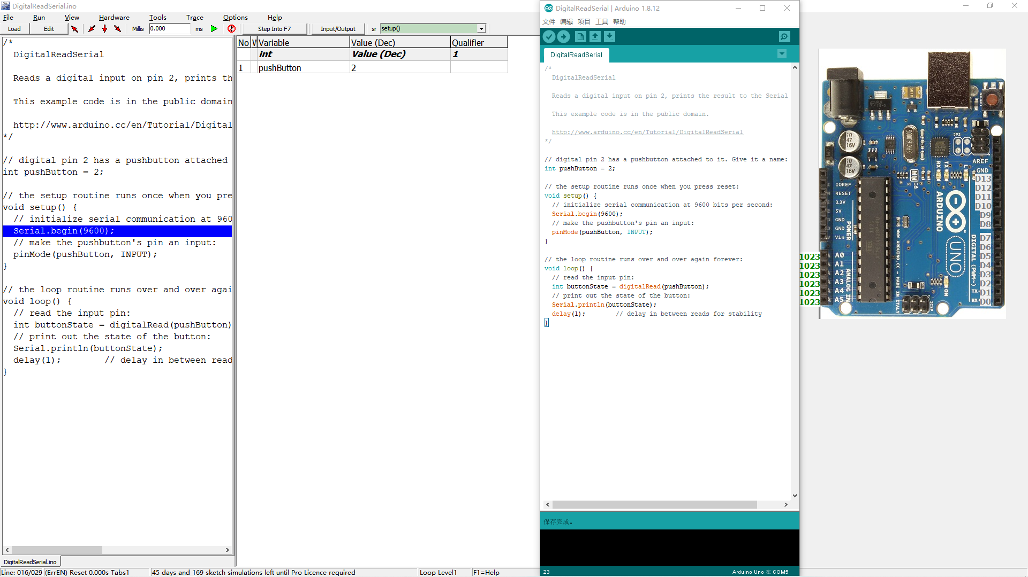
DigitalReadSerial

Slide 3
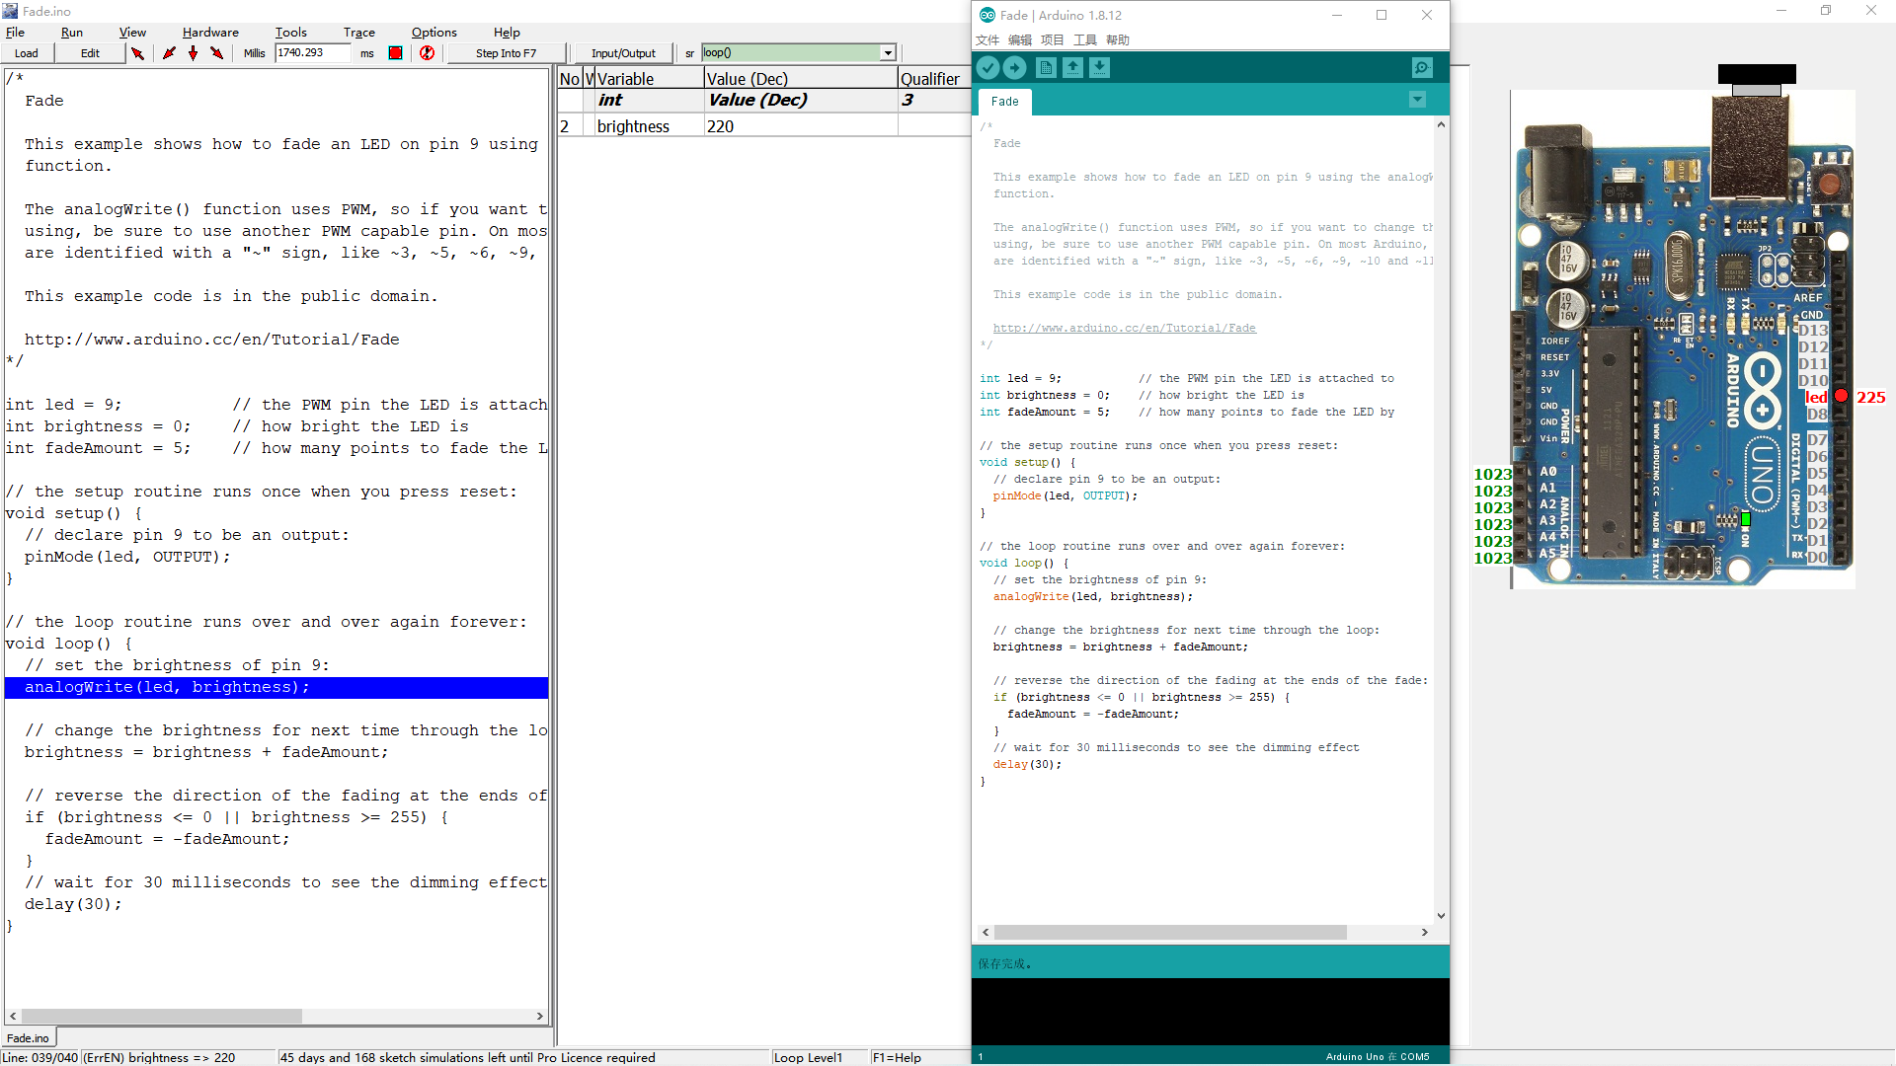
Fade

Slide 4
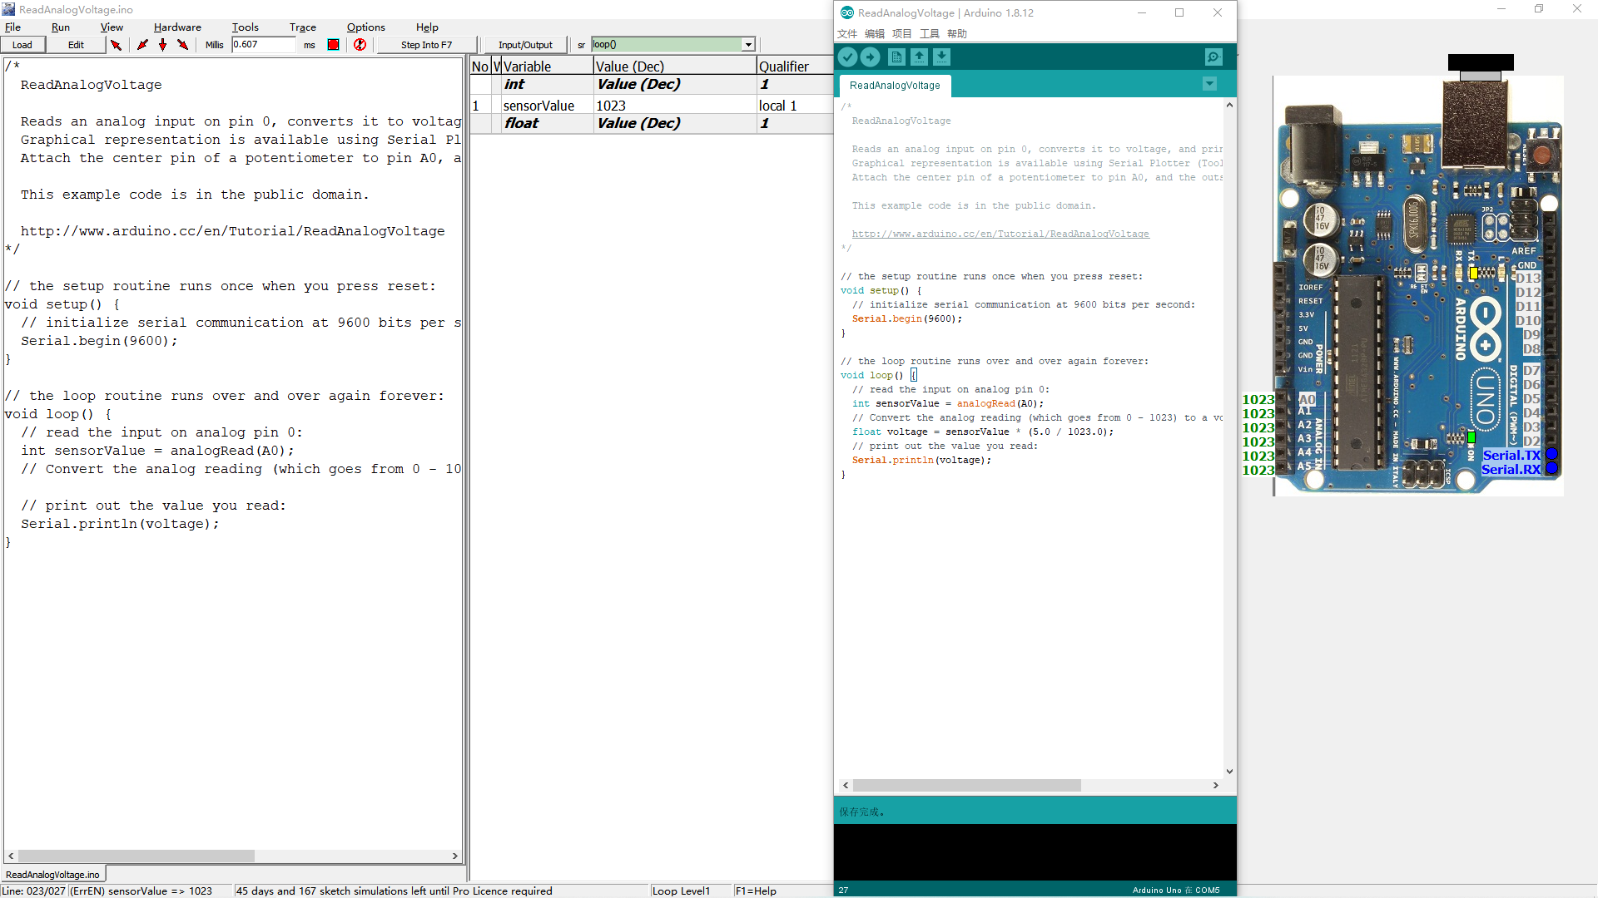
ReadAnalogVoltage

Slide 5
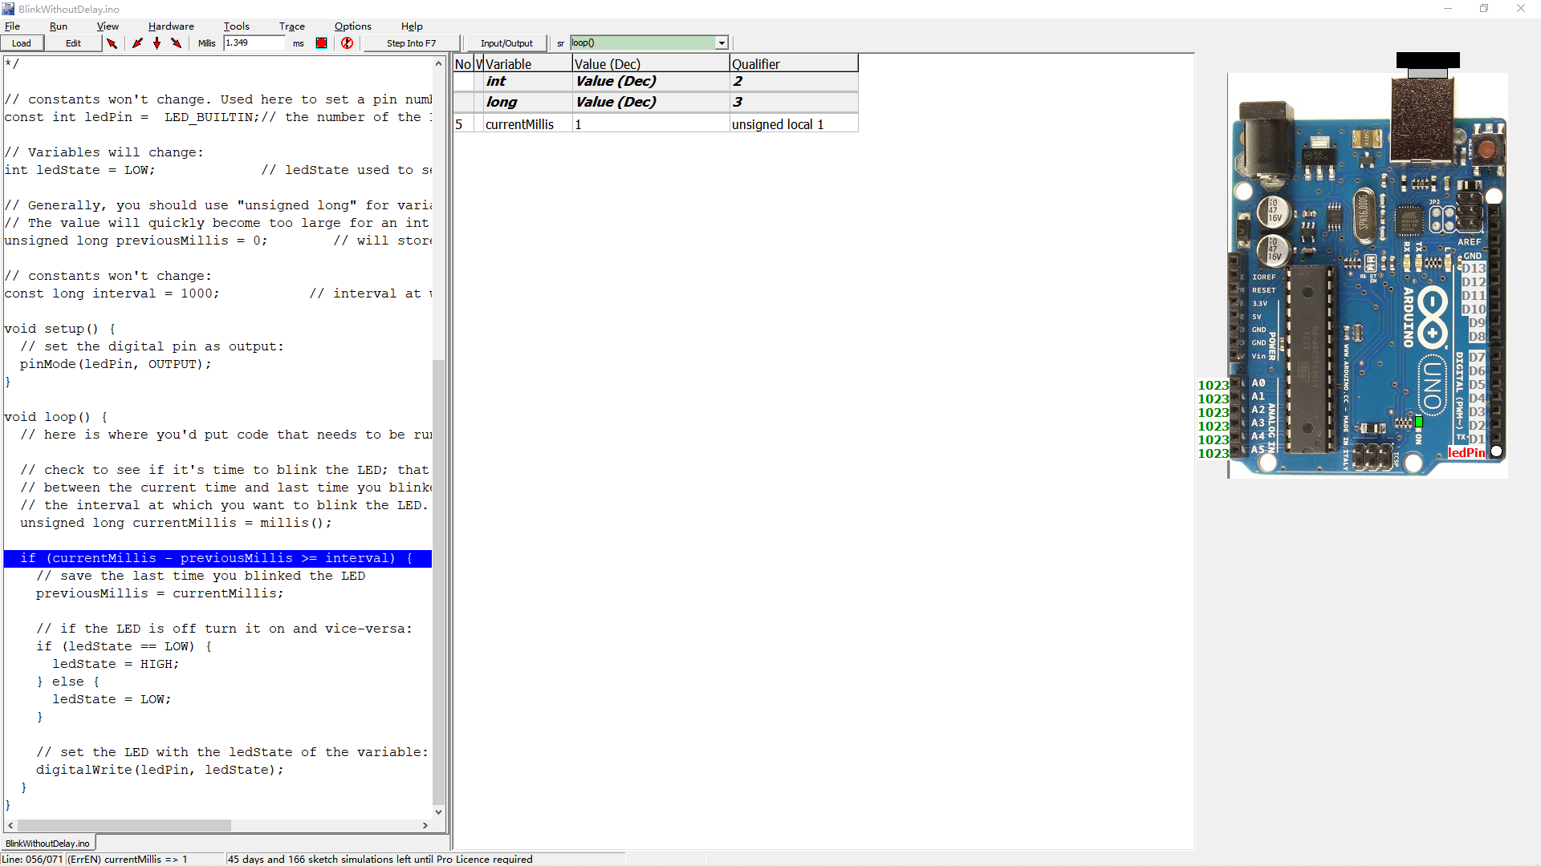
BlinkWithoutDelay

